Slide 1

Progetto OPTIMA
Management and compliance in ERAbS
Dr. Antonio Braun
Dr.ssa Arianna Corvasce
Ospedale Santa Maria, Bari

Slide 2

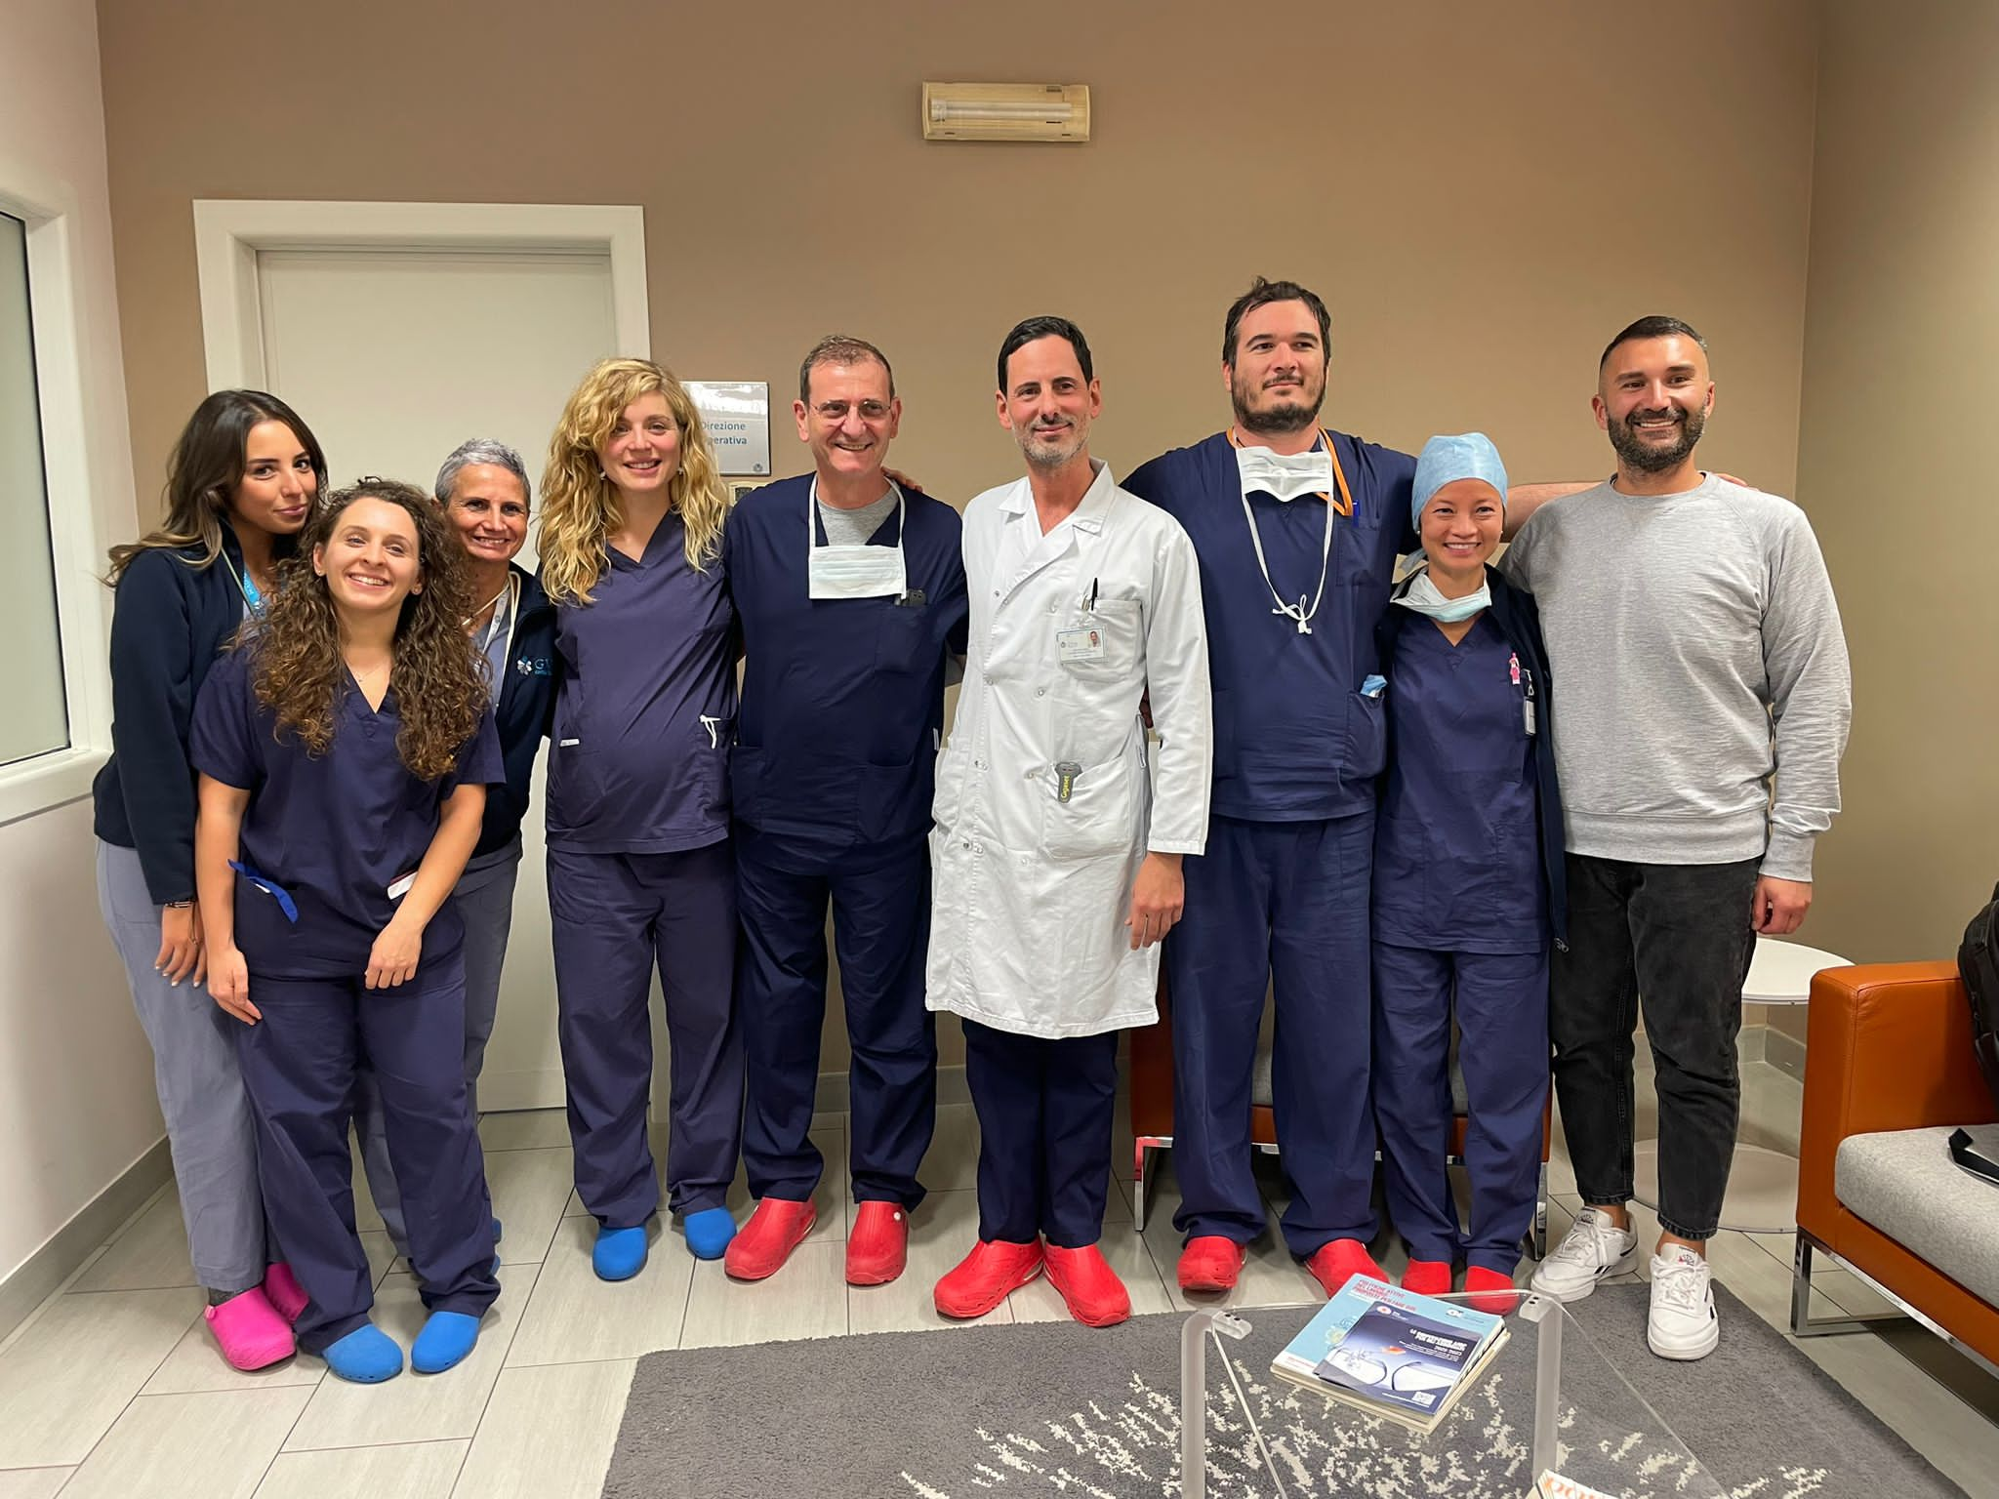
In november 2023 we became ERAS certified center for bariatric surgery
100 laparoscopic surgical procedures from july to october 2023: 34 gastric bypass, 66 sleeve gastrectomy

Slide 3

ERAS pathway — pre-admission / preoperative
Preparazione del paziente: educazione, ottimizzazione e prevenzione
Preparazione del paziente
• Patient education & counselling
• Smoking / alcohol cessation
• Prehabilitation
• Nutritional screening & treatment
Ottimizzazione prima dell’intervento
• Preoperative weight loss (bariatric-specific)
• PONV screening & prophylaxis
• Pre-anaesthetic multimodal analgesia
• Appropriate fasting / avoid unnecessary NPO

Slide 4
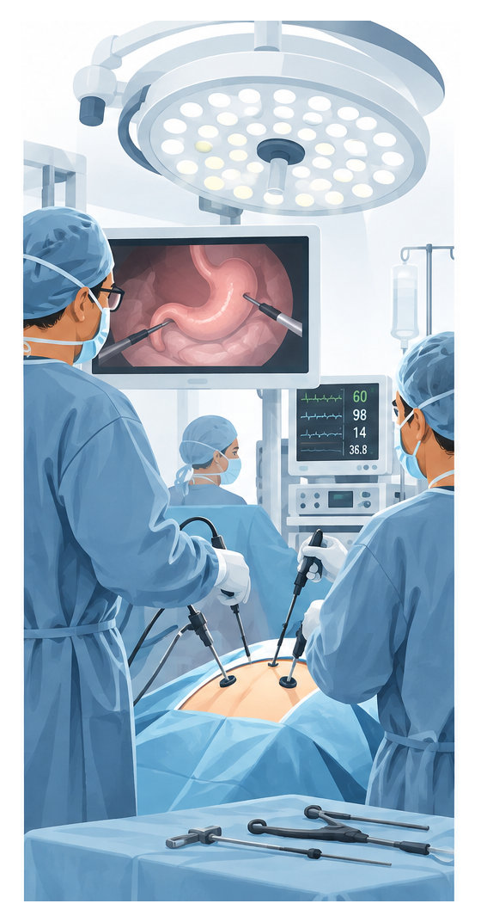
ERAS pathway — intraoperative
Obiettivo: chirurgia mininvasiva, stabilità fisiologica e analgesia opioid-sparing
Anestesia e ventilazione
• Short-acting anaesthetics
• Lung-protective ventilation
• Maintenance of euvolemia
• Goal-directed fluid therapy when appropriate
Tecnica e comfort
• Minimally invasive surgery
• Avoid unplanned hypothermia
• Multimodal, opioid-sparing analgesia

Slide 5

ERAS pathway — postoperative
Recupero precoce, nutrizione e follow-up
Recupero precoce
• Early extubation
• Avoid / early removal of drains & tubes
• Thromboprophylaxis
• Early oral nutrition / return to normal diet
Mobilizzazione e continuità
• Early mobilization
• Multivitamin + mineral supplementation
• Follow-up & audit / feedback
Bariatric-specific: lifelong vitamin/mineral supplementation and nutritional biochemical monitoring; postoperative ursodeoxycholic acid even without gallstones.

Slide 6
A strong starting point
We already had a good level of compliance before ERAS. The project focused on making our pathway more standardized, measurable and consistent.
Rather than changing everything, we built on what was already working and strengthened the areas with room for improvement.
Compliance incl. pre admission
73.9%
Perioperative compliance
81.8%
Pre admission
16.1%
Pre operative
83.1%
Intra operative
85.5%
Post operative
78.1%
WHAT WE STRENGTHENED WITH ERAS
• More standardized fluid management and increased oral hydration
• Opioid-sparing pain management and avoidance of routine abdominal drainage
• Earlier mobilisation and a more structured patient pathway
• Structured data collection, audit and feedback to support continuous improvement

Slide 7
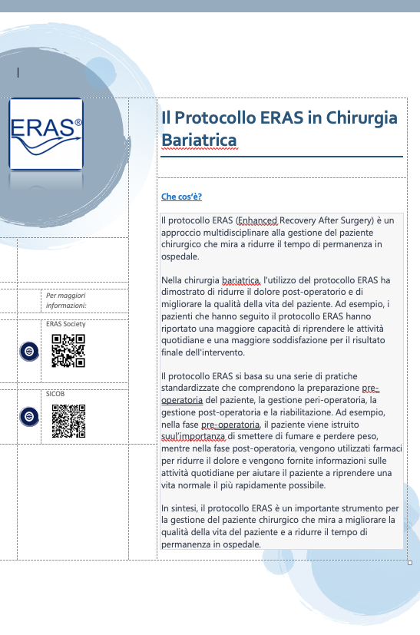
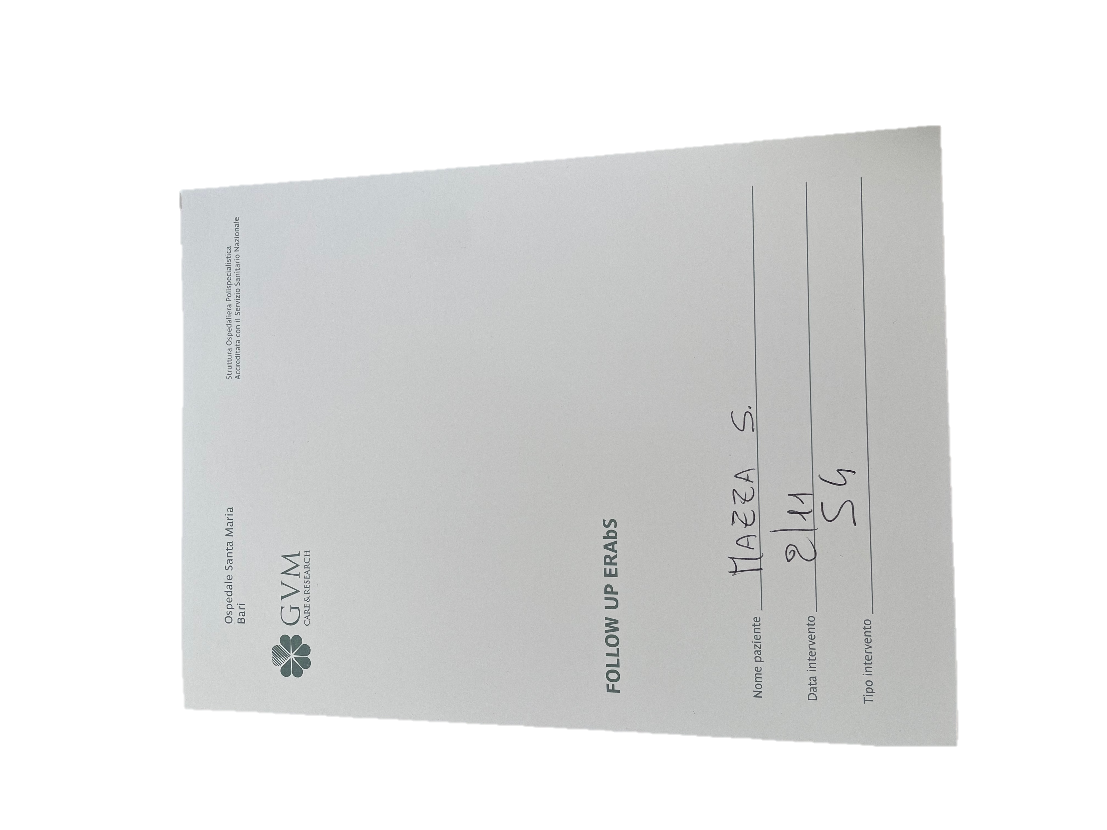
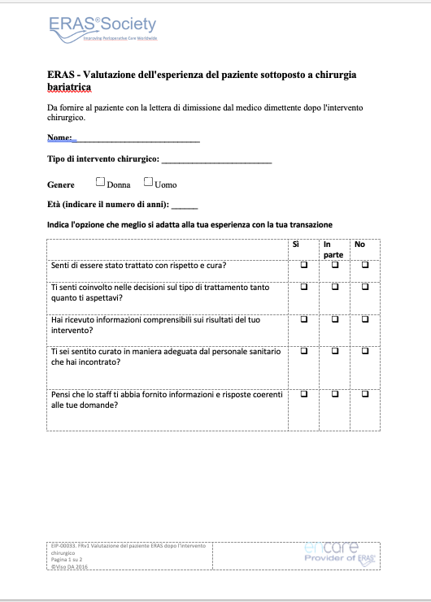
What ERAS changed for our patients
A clearer pathway from preparation to follow-up.
PATIENT JOURNEY
• Structured preoperative information
• Pre-op brochure
• Pre-discharge evaluation
• Follow-up folder
WHAT PATIENTS EXPERIENCED
• Less pain without drainage
• Easier mobilisation
• Earlier discharge
CONTINUITY OF CARE
• Clearer expectations
• More structured follow-up
• Easier postoperative management
PATIENT PATHWAY
01
02
03
04
05
Education
Surgery
Early recovery
Discharge
Follow-up

Slide 8
What ERAS changed for the team
The main change was to work with the same pathway and the same data.
TEAMWORK
• Structured data collection
• Nurses’ and intraoperative data
• Shared perioperative language
DATA & IMPROVEMENT
• Easier database management
• Analysis and audit
• Data available for future improvements
DATA FLOW
Collection
Database
Analysis
Improvement

Slide 9
The most visible changes in daily practice
We moved from a less standardized approach to a more consistent ERAS pathway.
BEFORE ERAS
WITH ERAS
Perioperative practice
• Fluid management not standardized
• At least 3000 cc IV fluids
• Frequent use of NaCl
• IV painkillers for more days
• No local anaesthesia
• Standard abdominal drainage
Standardized ERAS pathway
• More standardized fluid management
• Increased per os hydration
• Opioid-sparing approach
• No abdominal drainage
• Easier mobilisation
• Earlier discharge
The key point is the pathway: several small changes became one standardized perioperative process.

Slide 10
How we put ERAS into practice
The implementation was progressive: we changed the pathway, collected data and used the results to refine our practice.
01
Preoperative communication
04
Fluid management
02
Patient compliance
05
Teamwork & communication
03
No routine drainage
06
Data collection & audit
These changes made patient management more structured and gave us data to guide the next steps.

Slide 11

From implementation to certification
Once the pathway, teamwork and data collection were consolidated, we reached ERAS certification in November 2023.
PATIENT
Education → pre-discharge evaluation → follow-up
PERIOPERATIVE CARE
Standardization → fluid management → no routine drainage → mobilisation
TEAM & DATA
Collection → database → analysis → continuous improvement
EVALUATION
With the help of the ERAS team of the Centre Hospitalier de Valenciennes, managed by dr. Guido Liddo
NOVEMBER 2023
ERAS certified centre for bariatric surgery

Slide 12
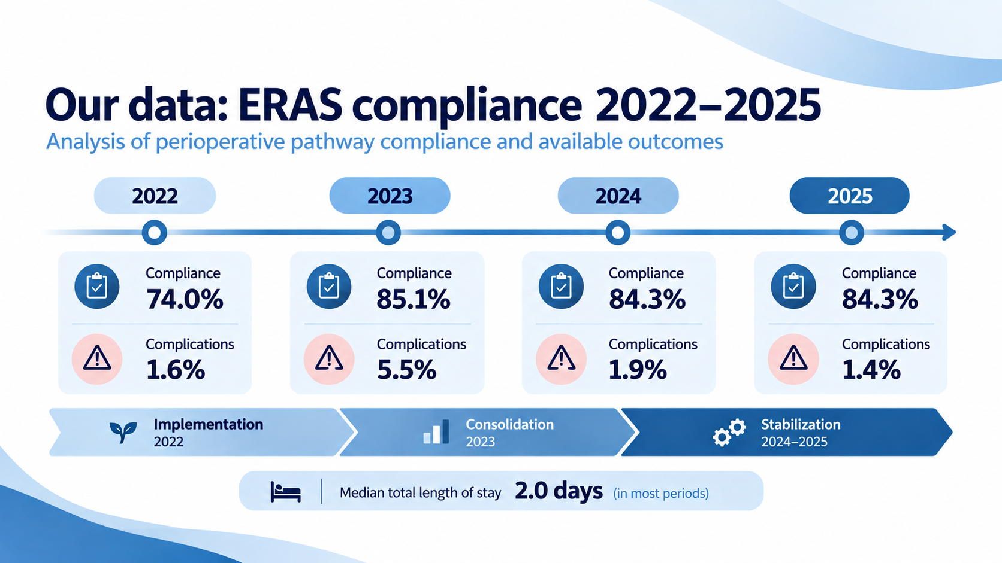

Slide 13
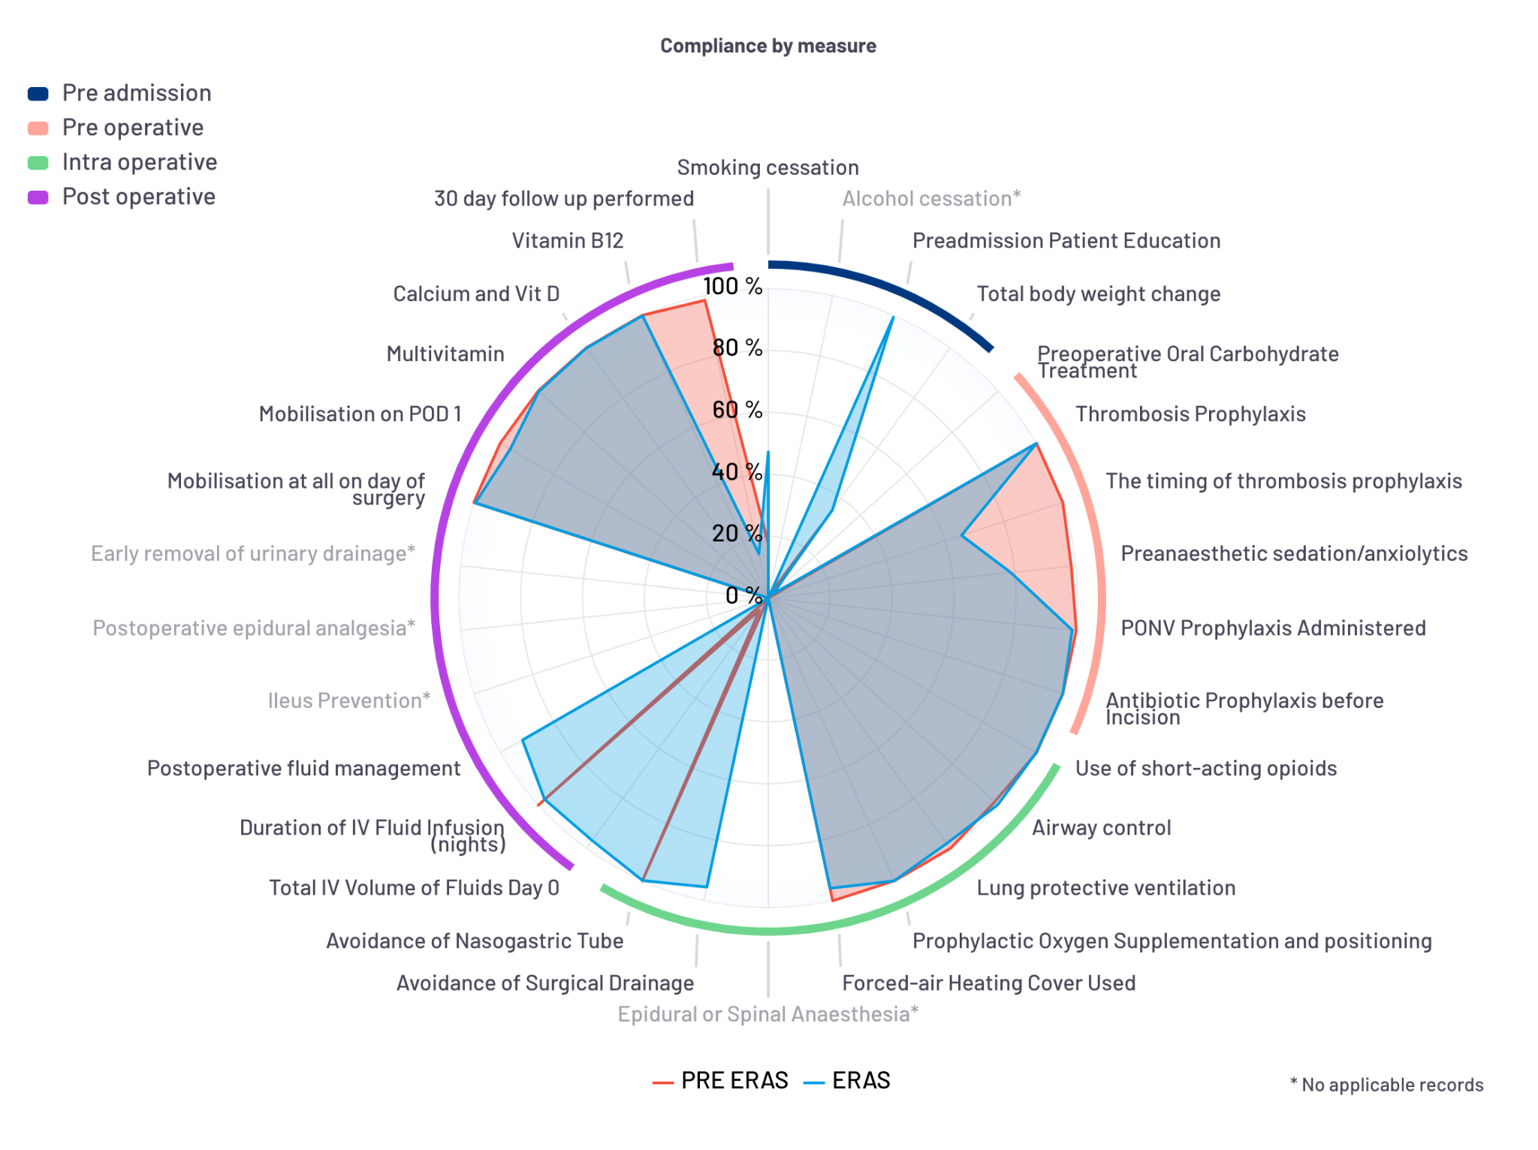
Where did we improve?
The radar shows the same ERAS measures before and after implementation.
WHAT THE COMPARISON SHOWS
• Baseline compliance was already high in several perioperative measures.
• ERAS strengthened standardization across the pathway.
• The main remaining gaps are smoking cessation, thromboprophylaxis timing and 30-day follow-up.
The message is not a single dramatic change, but a more complete and standardized pathway.

Slide 14
Our compliance — pre-admission / preoperative
Preadmission patient education
91.9%
Segnale forte
• Thrombosis prophylaxis
• PONV prophylaxis
• Antibiotic prophylaxis before incision
Smoking cessation
43.2%
Thrombosis prophylaxis
100.0%
Timing of thrombosis prophylaxis
68.2%
PONV prophylaxis
98.8%
Antibiotic prophylaxis before incision
100.0%
Area di maggiore margine di miglioramento: smoking cessation e timing della tromboprofilassi.

Slide 15
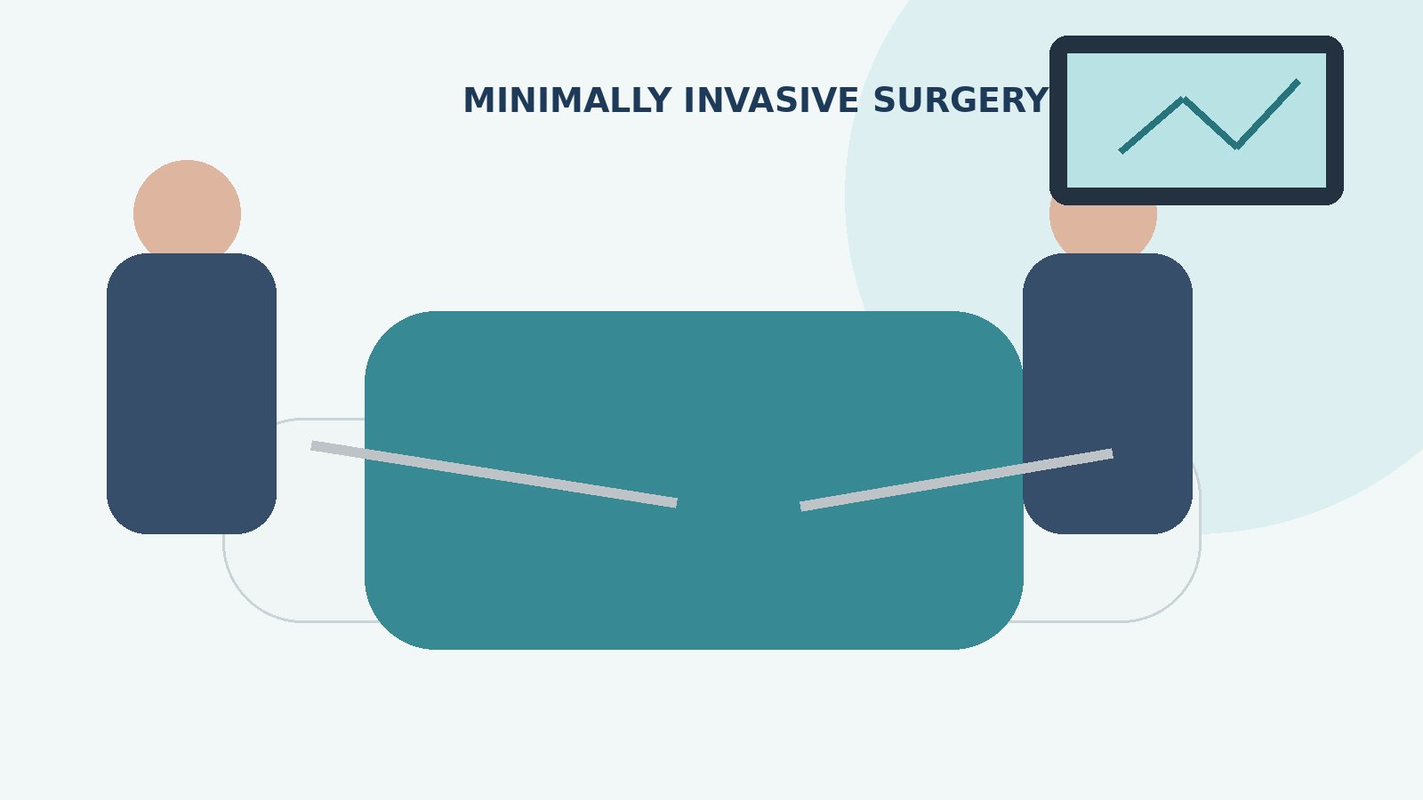
Our compliance — intraoperative
Short-acting opioids
99.9%
Forced-air warming
96.2%
Airway control
99.6%
Avoidance of surgical drainage
88.2%
Lung-protective ventilation
98.2%
Avoidance of nasogastric tube
99.9%
Prophylactic oxygen + positioning
100.0%

Slide 16
Our compliance — postoperative
Recupero precoce e supplementazione: compliance molto elevata; follow-up a 30 giorni resta critico
IV fluid duration
97.4%
Multivitamin
99.8%
Postoperative fluid management
84.6%
Calcium + vitamin D
99.9%
Mobilisation on day of surgery
99.5%
Vitamin B12
99.9%
Mobilisation on POD 1
96.5%
30-day follow-up performed
21.0%
30-day follow-up: 21.0% performed; 47.9% no data.

Slide 17
What we learned
The implementation improved everyday management, while also showing us where the pathway still needs work.
WHAT WORKED
• Less pain without drainage
• Easier mobilisation
• Earlier discharge
• Easier patient management
WHAT REMAINS
• Trust in oral intake on POD 0
• More paperwork and database complexity
• Involvement of out-of-hospital physicians
• Preoperative compliance
The remaining gaps identify the next targets for improvement.

Slide 18
What do our data tell us?
Overall, compliance improved over time, while length of stay remained stable and complications decreased after 2023.
COMPLIANCE
La compliance aumenta dal 74,0% nel 2022 a >84% nel triennio 2023–2025.
COMPLICATIONS
Dopo il 5,5% del 2023, il tasso scende a 1,9% nel 2024 e 1,4% nel 2025.
LENGTH OF STAY
La mediana della degenza totale è prevalentemente pari a 2 giorni nel periodo rappresentato.
NEXT TARGETS
Le aree con maggiore margine di miglioramento sono smoking cessation, timing della tromboprofilassi e follow-up a 30 giorni (bias inserimento dati).

Slide 19
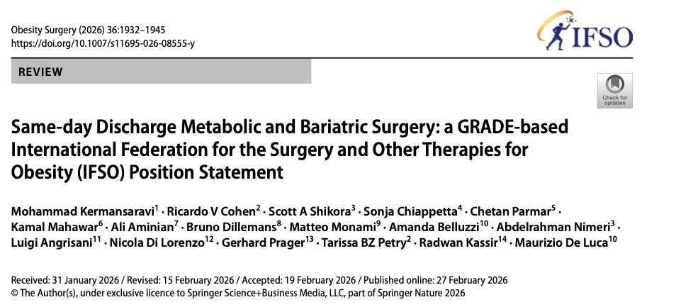
Same-day discharge: what does the latest evidence show?
17
studi inclusi
46.578 pazienti complessivi
4
RCT
n = 2.026
MODERATA
certezza
complicanze, readmission, mortalità
SDD
approccio sicuro
in pazienti appropriamente selezionati
RCT — SDD vs ricovero convenzionale
• Complicanze: OR 1,49; 95% CI 0,63–3,52; p=0,37
• Readmission: OR 2,20; 95% CI 0,49–9,87; p=0,30
• Mortalità a 30 giorni: OR 0,87; 95% CI 0,12–6,22; p=0,89
Messaggio clinico
• SG primaria: SDD proponibile in pazienti selezionati
• RYGB primaria: SDD proponibile in pazienti selezionati
• Revisionali: solo pazienti altamente selezionati
• Da evitare con complicanze significative, fine intervento tardiva o accesso limitato alle cure
[1] Kermansaravi M et al. Obesity Surgery. 2026;36:1932–1945. DOI: 10.1007/s11695-026-08555-y

Slide 20
SDD: patient selection and safety conditions
Il punto non è soltanto “dimettere prima”: è costruire un percorso che renda la dimissione precoce prevedibile e sicura.
SLEEVE
• Primary SG
• Strong recommendation
• Moderate certainty
RYGB
• Primary RYGB
• Strong recommendation
• Moderate certainty
REVISIONAL
• Revisional MBS
• Conditional recommendation
• Very low certainty
La selezione e la stratificazione del rischio restano centrali, soprattutto nei pazienti complessi.
[1] IFSO Position Statement 2026 — raccomandazioni GRADE

Slide 21


